Slide 1

COVID-19 BOT
Group: J. Aditi Patel (18BD1A052Q)
A. Bhandavi (18BD1A0522)
Faseeh Ahmed (18BD1A053H)
M. Samendu Reddy (18BD1A053J)

Slide 2
Abstract
Chatbot is a computer program designed to simulate conversation with human users, especially over the internet. Simple chatbots work based on pre-written keywords that they understand, each of these commands must be written by the developer separately using regular expressions or other form of string analysis, if the user has asked a question without using a single keyword the bot cannot understand it and as a rule responds with default messages. Smart chatbots rely on artificial intelligence when they communicate with the users instead of pre-prepared answers the bot responds with adequate suggestions on the topic. A COVID-19 bot helps the user to get answer related all the queries/FAQ Related to Covid-19like Help Desk,Live News,Govt Announcements,Images and Videos related to Covid-19 etc.

Slide 3
Introduction
Chatbots have been on the rise ever since machine learning and NLP have gained prominence. They have managed to penetrate into various field like healthcare, stock, customer care, entertainment and banking.
NLP helps the computer develop a understanding of human behavior so that it can create a proper communication channel for the user.
A Covid19 chat bot is going provide a person with information regarding the number of covid cases based on the area input provided and if he/she needs to be vaccinated a suitable appointment is shown depending on vaccine choice provided by the user.
Additionally provides information regarding helpful resources like plasma and oxygen.

Slide 4
Chatbots made during Covid
Common people came together during hard times and to play a part in the world’s fight against covid they developed chatbots which were enabled on WhatsApp for use for general public.
A text is easier to make than call nowadays and during busy hours it is far more efficient as you can simultaneously communicate with multiple people and provide accurate and fast responses.
Chatbots during Covid where mostly area oriented and were mainly made in language widely used in that area, which is an another benefit provided by NLP as English is not the only language it supports.
The outcome of this project is to provide a chatbot which would help with the harsh conditions provided by COVID19.

Slide 5
Technologies and FrameWorks Used
Technologies :
Dialog flow: A natural language processing platform which is used to design and integrate a chatbot interface with mobile applications, web applications and devices.
Postman: For testing the chatbot.
RapidAPI: Gathering information that the chatbot has to provide to the user.
Framework:
Flask: A python based framework for application and is compatible with google app engine

Slide 6
System Requirements
Software requirements:
PyCharm
MongoDB
Twilio
Hardware requirements:
CPU: Intel core i5 or Above, AMD Ryzen 5 or Above
GPU: Intel Integrated Graphics or higher
OS: Microsoft Windows 10 or above.
Mobile Phone with WhatsApp.

Slide 7
Requirement Specification
Functional Requirements:
• The Proposed system should be capable to understand the query faced by the user and provide the appropriate answer.
• The answers should prompt and if a invalid input is provided the user should be informed.
Non Functional Requirements:
• A database should be provided for Covid related details.
• The provided database should be checked for consistency and be updated when needed.

Slide 8
Proposed System Functionalities
Bot should be able to answer all the queries/FAQ Related to Covid-19.
Bot should be able to show statistics worldwide,COuntry wise,Indian State,District,On GoogleMap using 3rd Party API.
Able to show Help Desk,Live News,Govt Announcements,Images and Videos related to Covid-19.
Able to save User-Bot conversation on Database.
Able to send Report to User Email with Prevention Measure Attachments.
Able to say If a person has got vaccinated or not.

Slide 9
Modules
1.Google DialogFlow
2.Flask/Python,API,MongoDB
3.Testing & DeployMent

Slide 10
Google Dialog Flow
1.Create Agent
2.Create Intents,Entity,Training Phrases,Action,Response
3.Create Knowledge Base
4.Fulfillment & Integration

Slide 11
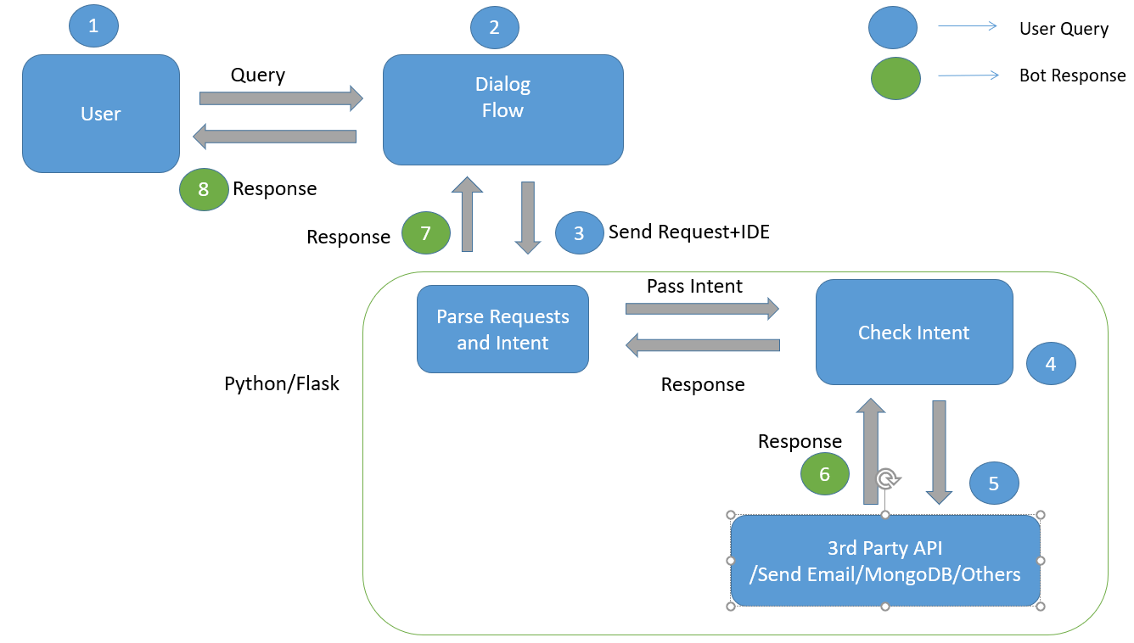
Use Case Diagram

Slide 12
Flow Diagram
Welcome Intent
Exit
Help Desk
Show Emergency nos
FAQ
Statistics
Live News
Show Data
Vaccine
Resources
Indian States
Total Worldwide
Report District Wise
Mapwise cases
Country

Slide 13
Literature Survey
DialogFlow ES Documentation
Deep Learning Based ChatBot
Covid-19 Symptom Checker
Flask Documentation
Open Domain Chatbot

Slide 14
Thank You

